Slide 1
La Voix Passive

Slide 2
On utilise la voix passive quand le sujet subit l’action.
Pour faire une phrase affirmative:
Le sujet
L’auxiliaire BE (conjugué)
Le Participe passé

Slide 3
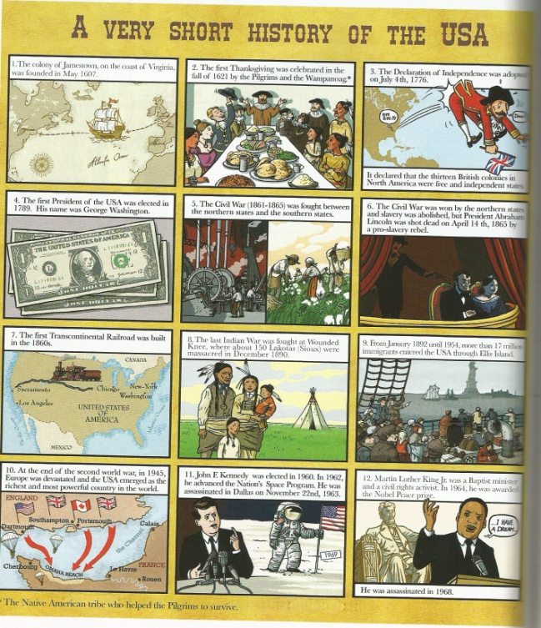
Les Questions à la voix passive

Slide 4
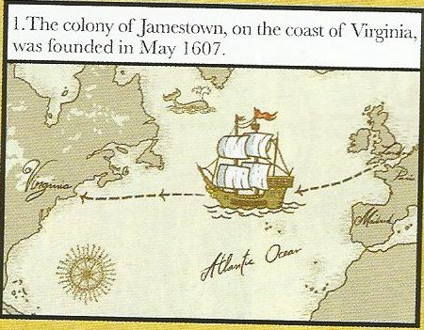
The Colony of Jamestown was founded in May 1607.

Slide 5
The Colony of Jamestown was founded in May 1607.
The Colony of Jamestown
was
WHEN ?
founded

Slide 6
Pour poser une question à la voix passive, on inverse le ________ et _________________ _____:
SUJET
L’AUXILIAIRE B E
1. MOT
INTERROGATIF
2. L’AUXILIAIRE
BE
3. SUJET
4. PARTICIPE
PASSÉ
(5. la suite)

Slide 7
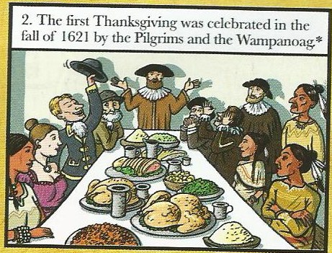
The first Thanksgiving was celebrated in 1621 by the Pilgrims and the Wampanoag (Indians).

Slide 8
The first Thanksgiving was celebrated in 1621 by the Pilgrims and the Wampanoag (Indians).
The first Thanksgiving
was
celebrated
WHEN ?
WHO by?
was the first Thanksgiving celebrated

Slide 9
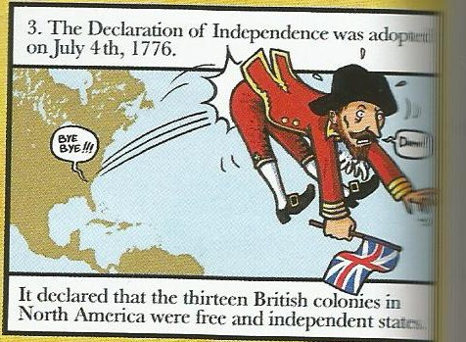
The Declaration of Independence was adopted in 1776.

Slide 10
The Declaration of Independence was adopted in 1776.
was the Declaration of Independence adopted
WHEN ?

Slide 11
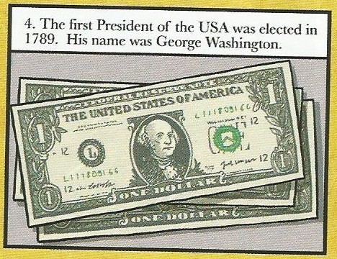
The first president / George Washington was elected in 1789.

Slide 12
The first president / George Washington was elected in 1789.
WHEN ?
was George Washington elected
WHO ?
was elected in 1789

Slide 13
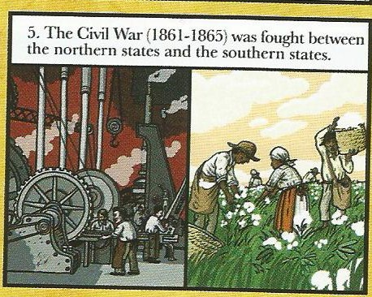
The Civil War was fought by the Northen and the Southern States.

Slide 14
The Civil War was fought by the Northen and the Southern States.
WHO ?
was the Civil War fought by

