Slide 1
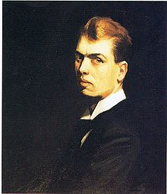
Edward Hopper (July 22, 1882 – May 15, 1967) was an
American realist painter : he painted lots of oil paintings
and watercolours.
2. BIOGRAPHY : diaporama/ anticipation
+ doc MP3
3. Un tableau : travail de l’intro (sur ce diaporama)
- TABLEAUX : les 3 de la bio. MP3
2 tableaux = intro à faire en cours / modèle vu en 3.
3ème tableau = donner intro à faire en homework
4. Méthode / analyse d’un tableau
Choix d’un tableau et entraînement oral .
5. Séance en français // épreuve brevet
( uniquement pour les élèves qui choisiront de présenter une
oeuvre de E. Hopper au brevet)

Slide 2
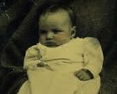
WANT to FIND OUT ABOUT
EDWARD HOPPER ???
When and where was he born ?
What was his nationality ?

Slide 3
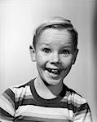
His childhood
Where did he grow up ?
Did he have a happy childhood ?
What did he enjoy doing when he was a kid ?
What was he good at ?

Slide 4
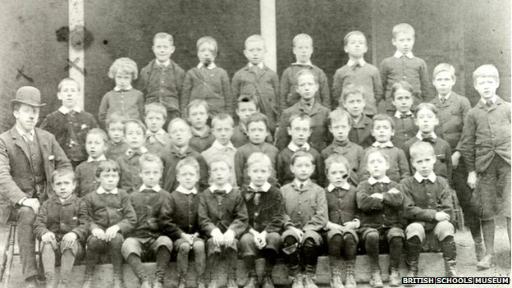
His education
Which school did he go to ?
Where was he educated ?
What did he study ?
Where did he study ?

Slide 5
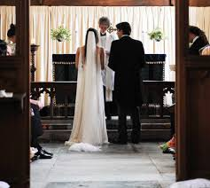
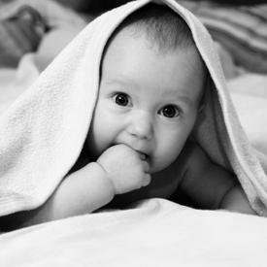
When did he get married ?
Who did he marry ?
Did he have any children ?
Did he ever get a divorce ?
If so, when ?
What did he do ?

Slide 6
When did he become famous ?
How did it happen ?
What happened to him ?
Which painting made him famous ?
Which exhibition …… ?
He struggled for years to sell a painting but he is today one of the most popular
American artists.

Slide 7
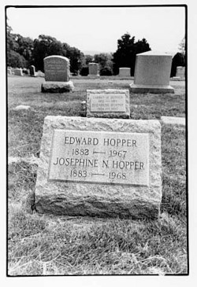
When did he die ?
Where is he buried ?
Where was he buried ?

Slide 8
So let’s recap!! You remember all the questions, don’t you?
Date and place of birth?
Childhood?
Education (place + what?)
Marriage(s)?
Children?
. Job ?
. Success ?
Date and place of death?
Burial place?
HOMEWORK (lien donné sur pronote) :
http://www.henry4school.fr/Art/alloing/EDWARD%20HOPPER%20webquest.pdf

Slide 9
C.O. // VOA – démarche
Chaque îlot travaille sur un extrait – bilan relevé et auquel sera attribué un
certain nombre de green points en fonction des infos trouvées par chaque îlot.
2. P.O. : questions / réponses
Les élèves posent de nouveau des questions ; l’ilôt qui a une réponse la
donne.
3. P.O. / PPC îlot
Questions de recap données à chaque îlot qui se prépare à ‘recap’ les infos
(Voir les diapos suivantes.)
4. Donner le homework :
HOPPPER ‘s biography / texte lacunaire
- + exo de matching : WU des questions et réponses
5. Prévoir un test : les questions // biography
6. INTRO. / savoir introduire une présentation de tableau
7. How to analyse a painting ( + situer éléments / tableau : foreground ….
8. Choisir un tableau et en préparer la présentation

Slide 10
Part 1 : recap P.O.
When and where was he born ?
What was his nationality ?
Where did he grow up ?
What did he enjoy doing when he was a kid ?
What was he good at ?
Did he have a happy childhood ?
What did he study ? When ? Where ?
Part 2 : recap P.O.
Who was his most important teacher ?
What did he paint ?
What did he advise his students to do ?
Did Hopper agree with him ?
How long did he study there ?
What did Hopper want to do ? Why ?

Slide 11
Part 3 : recap P.O.
What did he do in 1906 ?
Where did he live ? How long ? Did he go back there ?
Was he influenced by what he discovered ?
What did he prefer ?
Where did he settle when he got back to New York ?
What did he do for a living?
Where (+ when) did his first exhibition take place?
Was it successful ?
Part 4 : recap P.O.
When did he get married ?
Who did he marry ?
Did he have any children ?
Did he ever get a divorce ?
When did he become famous ?
How did it happen ?
So…what happened to him ?(//Which decision did he take?)
What could Hopper afford ?
// What did he and his wife buy ? What for ?

Slide 12
Part 5 : recap P.O.
What happened in the 1930S ?
Consequence: what about American people at that time ?
What did Hopper paint ? (What about his paintings?)
Why did people like his paintings ?
Part 6 : recap P.O.
When did he start having problems with his painting(s)?
2 problems ? - ……………………… + ……………………………… .
Were artists keen on realism at that time ?
What became more popular ?
When did he die ?
When did his wife die ?
What happened in 2004 ? Where ?
What is said about Hopper today ?

Slide 13
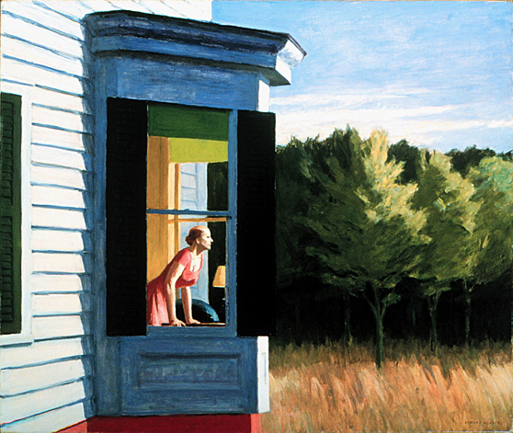
EDWARD HOPPER
1882-1967
It’s an oil on canvas
painted by …
…Edward Hopper, an
American artist who …..
……. in ……….and died
in ……. .
He painted it in …………
It is ……..
It’s entitled ……
It can be seen in the ………………..
It shows …………
Cape Cod Morning
1950
86.7 x 102.3 cm.
Smithsonian American Art Museum
it shows a woman looking out … ; what is she thinking about ? Does she look sad or happy?
It’s early morning : the sun’s rising …
It shows a brightly colored house in the country.
In the middle of the painting, a woman leans on a table and looks out a window.
She looks very sad. However, nothing in the painting gives any idea about why
she would be sad.

Slide 14
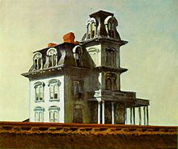
EDWARD HOPPER
1882-1967
It’s an oil on canvas
painted by …
…Edward Hopper, an
American artist who …..
……. in ……….and died
in ……. .
He painted it in …………
It is ……..
It’s entitled ……
It can be seen in the ………………..
It shows …………
House by the Railroad
1925
61 x 73.7 cm.
The Museum of Modern Art, New
York.
A house : it is closed and isolated, as if lost in the middle of nowhere.
– morning light – nobody can be seen ..
ANALYSIS :
http://www.moma.org/collection/object.php?object_id=78330

Slide 15
Homework
Nighthawks

Slide 16
At the top
At the bottom
In the foreground
In the background
In the bottom left-hand corner
In the top right-hand corner
In the middle ground

Slide 17
At the top
At the bottom
In the foreground
In the background
In the bottom left-hand corner
In the top right-hand corner
Your turn now !

Slide 18
LET'S CHECK !
AT THE TOP
In the top right-hand corner
In the background
Your turn now !
IN THE MIDDLE GROUND
In the bottom left-hand corner
AT THE BOTTOM
IN THE FOREGROUND

